Slide 1
Analyzing the Relationship Between My Credit Card Spending and Weather Data
DSA210 Fall 2024-2025 Term Project
Aysın Nur İpek (32393)

Slide 2
Project Description
Objective: To explore how external factors such as temperature and weather conditions influence my personal spending habits by analyzing:
Credit card transaction data.
Weather patterns in my location.
Key Components:
Analyzing spending behavior across categories (e.g., groceries, dining).
Correlating spending patterns with weather variables like temperature and conditions.
Calculating basic statistics for meaningful insights.

Slide 3
Motivation
Why I chose this project?
Data Availability: My most detailed dataset is my credit card spending.
Continuous Variable: Weather provides consistent, measurable data.
Insights:
Identify seasonal financial habits.
Improve budgeting and planning.
I did not predict data for 2025.
Goals:
Discover actionable trends in spending across categories.
Analyze the impact of weather conditions on financial decisions.

Slide 4
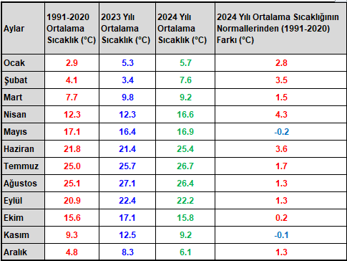
Data Sources
1. Credit Card Data:
Transaction Dates: Exact date of purchases.
Amounts: Value of each purchase.
Spending Categories: Groceries, dining, transportation, etc. Deleted irrelevant titles from Excel. (World Puan, etc)
Source: Manually converted from my credit card statements into an Excel file. At first the statements were seperated. I merged them and made one sheet, put them in chronological order, sum them based on categories and found their average.
2. Weather Data:
Daily Temperature: Includes average, maximum, and minimum temperatures.
General Weather Conditions: Weather conditions shows the average temperature 2024 .
Source: Extracted from publicly available weather images and converted into Excel format manually. Read the data from Excel file. I could not use WeatherStack API because my data was huge and it was over request limit.
So I found an image 2024 temperatures. Converted it to Excel, used in my code.
Meteoroloji Genel Müdürlüğü. Sıcaklık Analizi

Slide 5
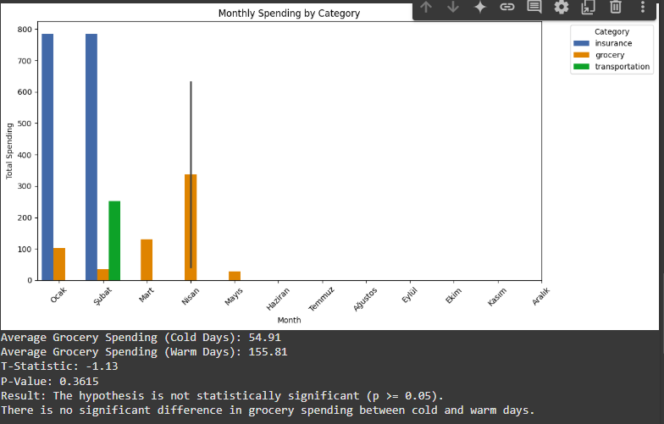
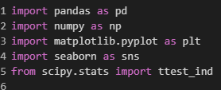
Techniques and Tools
Tools:
Python: Main programming language. I used Google Collab.
Pandas: Data manipulation and preprocessing.
NumPy: Statistical calculations.
Matplotlib/Seaborn: Visualization.
Data Analysis Techniques:
Visualization: Bar chart is used.

Slide 6
Data Visualization
Visuals Created:
Monthly Spending by Category:
Bar plots showing how spending differs across categories like groceries, dining, transportation.
I could have used heatmaps and scatterplot but I couldn’t.

Slide 7
Hypothesis Testing
Hypothesis: “I spend more on groceries during colder weather.”
Testing Approach:
Categorize days into Cold (<15°C) and Warm (≥15°C).
Compare average grocery spending for both categories.
Perform a T-Test to check statistical significance.
Results:
Cold Days Mean: 54.91 TL ( Ocak- Şubat-Mart)
Warm Days Mean: 155.81 TL
P-Value: Indicates whether differences are significant.
T-Statistic: -1.13 P-Value: 0.3615 Result: The hypothesis is not statistically significant (p >= 0.05). There is no significant difference in grocery spending between cold and warm days

Slide 8
Findings
Hypothesis Testing Results:
My Grocery spending is higher on cold days compared to warm days" was not supported.
Statistical analysis (T-test) showed that the difference in average grocery spending between cold days (54.91) and warm days (155.81) is not significant because p = 0.3615). Actually I was not expecting that grocery expenses is going to be low because I usually spend my time indoor and buying needs to cook or eat.
Key Insights from Visualization:
Spending patterns vary across months and categories.
Transportation and insurance spending showed more consistent trends, while grocery expenses varied more significantly.
General Observations:
While the hypothesis isn’t statistically significant, spending behaviors may still exhibit seasonal trends that require further exploration with a larger dataset or additional external factors

Slide 9
Future Work
In my future work, I plan to use more heatmaps and scatterplots because I could not use them in this Project.
I was planning to make prediction about 2025. I would also elaborate on prediction.

Slide 10
References
Meteoroloji Genel Müdürlüğü. (n.d.). Sıcaklık Analizi. Meteoroloji Genel Müdürlüğü. Retrieved January 10, 2025, from https://www.mgm.gov.tr/veridegerlendirme/sicaklik-analizi.aspx

